Slide 1
NigeriaMRS (NMRS)
Powered by: OpenMRS
NigeriaMRS (NMRS) Community - 2021

Slide 2
NigeriaMRS Overview
NMRS is acronym for Nigeria Medical Records System
An adaptation of the OpenMRS software to support HIV program in Nigeria
Supported program areas - HTS, PMTCT, ART
Modules include – Patient management, Data management, Data quality assurance, Commodities management, Reporting and Systems management
In use across over 1000 PEPFAR & GoN supported facilities in 21 states
Manages records of over 750,000 patients currently on treatment

Slide 3
Retention (Patient Reminders)
To achieve a sustainable implementation and in line with the need to optimize strategies for better retention of our clients, and in response to patient level issues that have contributed to IIT, the necessity for the use of SMS reminder systems came up.
Patient phone numbers are linked to a service that handles appointment reminders, this reminders are coded messages in other to avoid stigma. This reminders help boost facility retention numbers overtime. These automated reminders deliver messages for ‘Appointment Reminders, ARV Drug Pickups, Viral Load Test, Drug Adherence, etc.

Slide 4
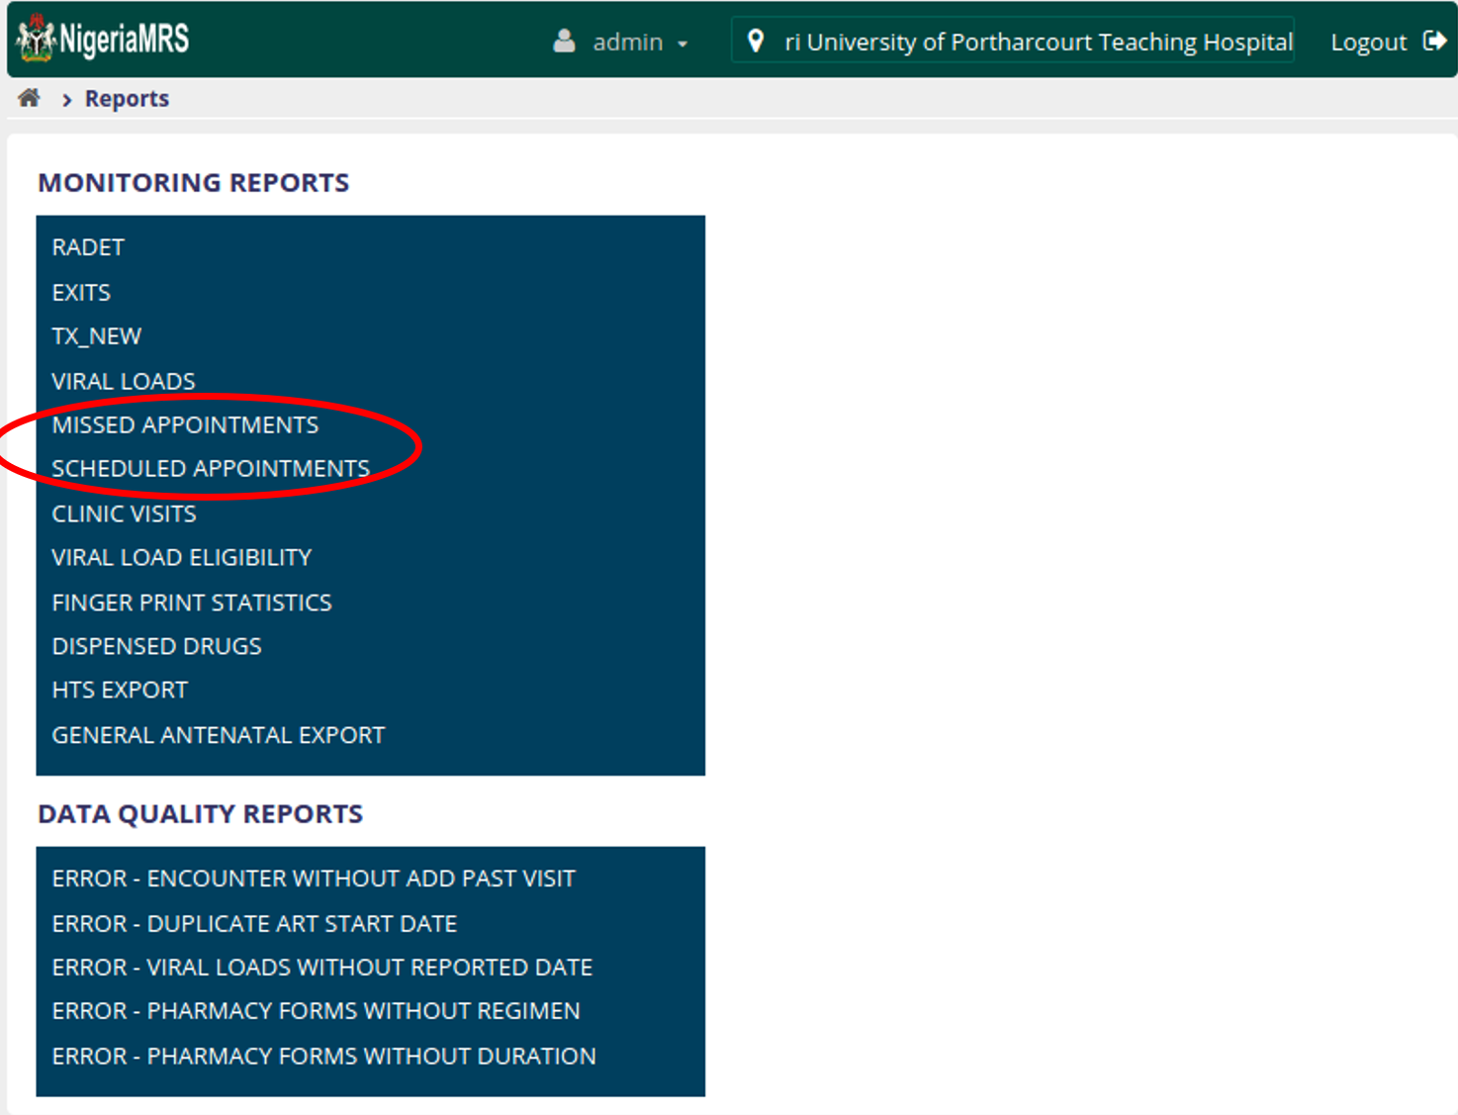
Scheduled & Missed Appointment Lists
Appointment lists facilitate both pre-emptive and early defaulter tracking to improve retention

Slide 5
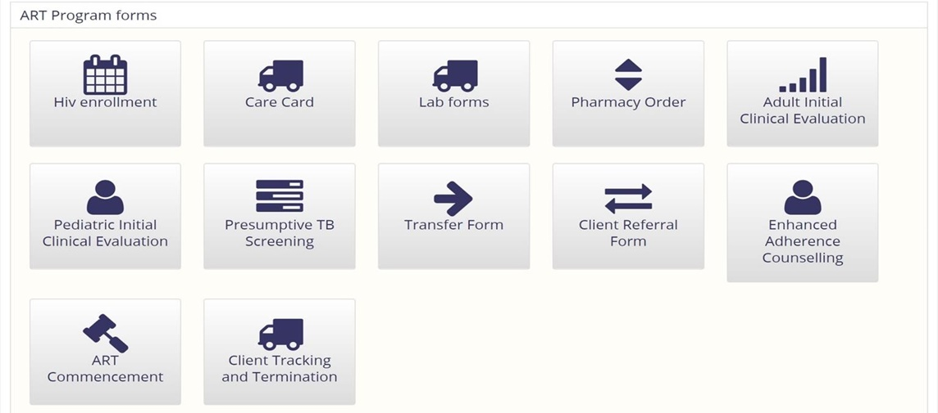
Reference App Treatment Forms

Slide 6
Program Implementation Results – Rivers Surge

Slide 7
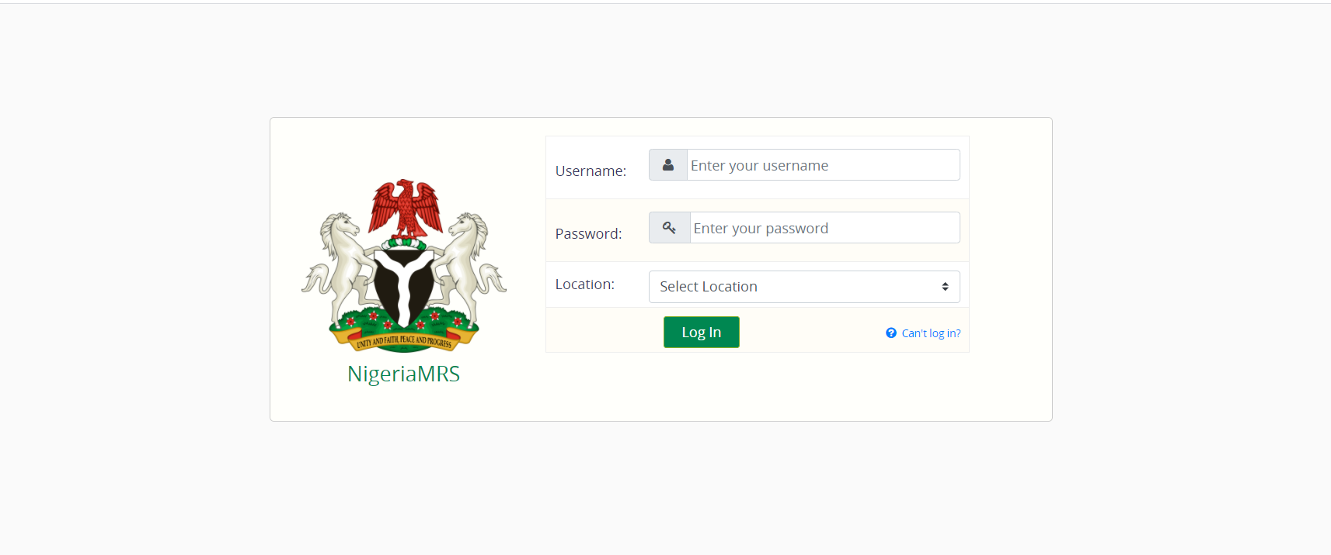
Point of Care Module
Point of Care: Point of care system has also been implemented and set for full scale deployment this year which is part of our primary focus for 2021.
The system is mainly focusing on HIV implementations but we have plans to scale-up to other disease areas which we have already started discussing with stakeholders.

Slide 8
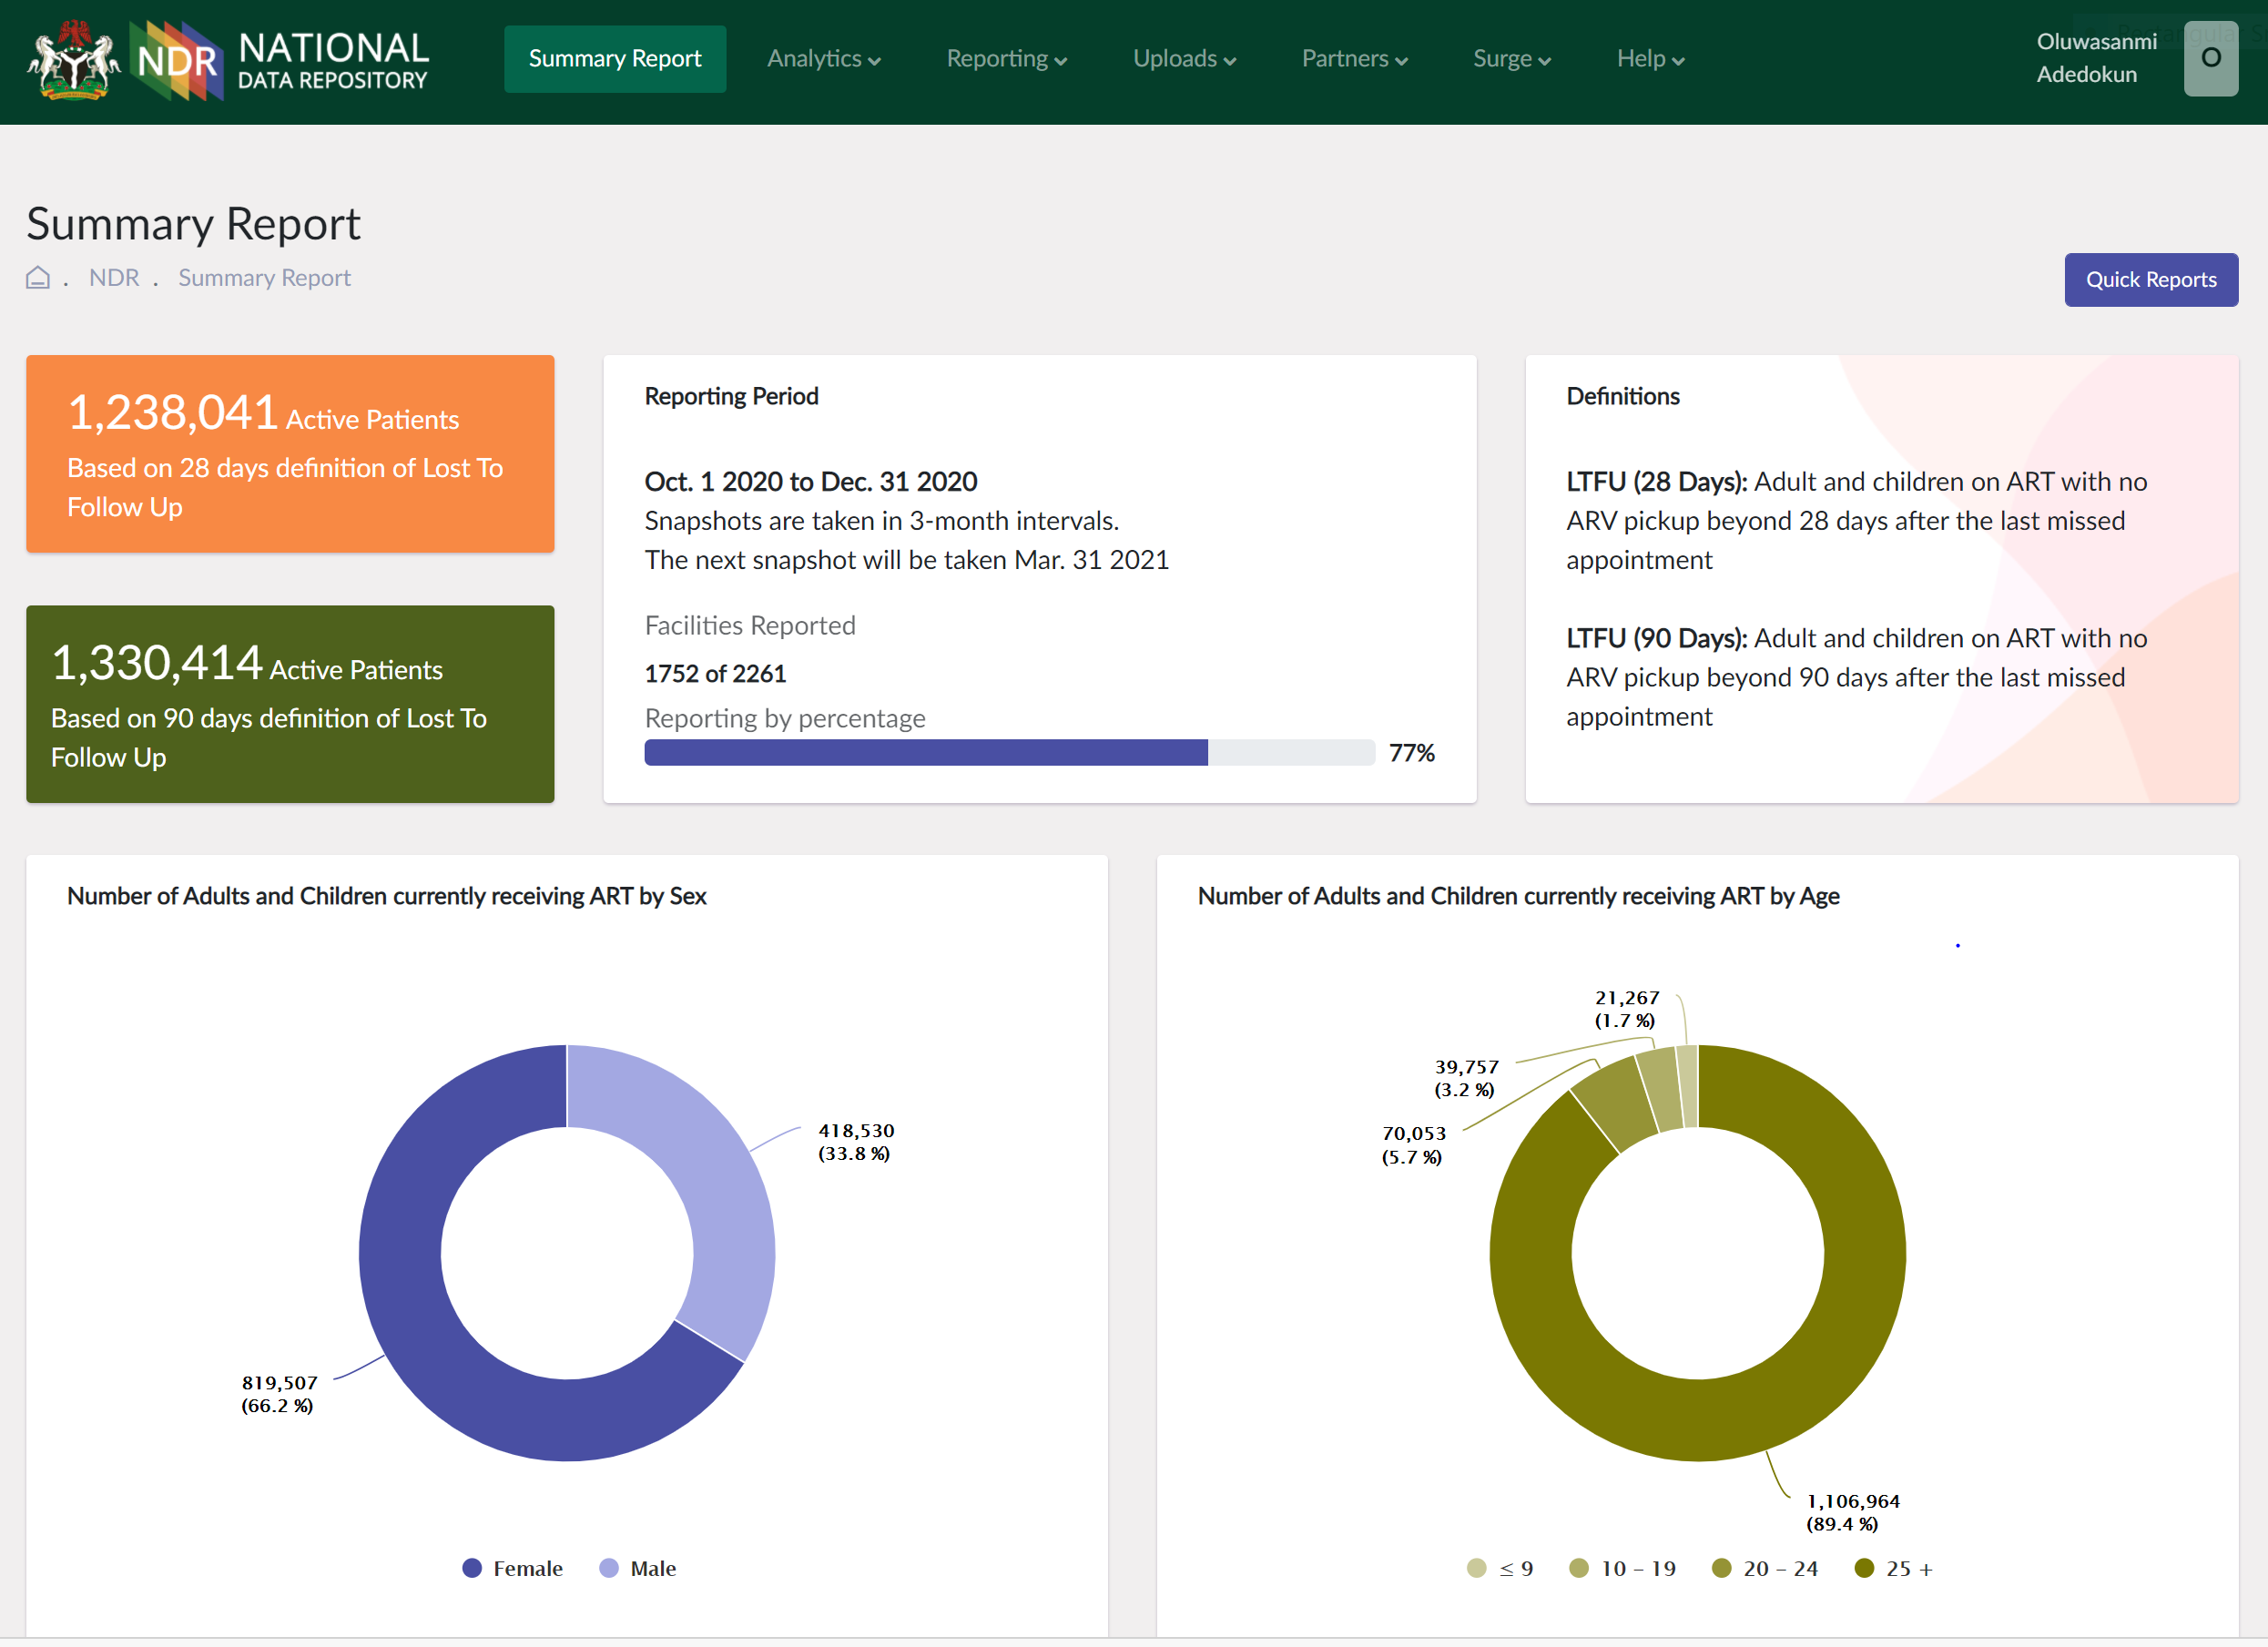
National Data Repository (NDR)
All HIV data from various NigeriaMRS implementation across the country by partners are mandated to provide daily reports to the National Data Repository.
Presently collecting HIV data with plans to accommodate other disease areas.

Slide 9
Lab Information Management System (LIMS)
The Lab Information Management System (LIMS) provides flexibility to hospital labs allowing them to send electronic manifests for Viral Load Samples to Registered PCR labs across states, and receive results electronically on the NMRS instance via an API end-point. .
The LIMS also has a standalone functionality called Remote Sample Login (RSL) for sites without EMR.

Slide 10
Patient
Biometric
Service (PBS)
The implementation and deployment of the biometric system can help prevent identity error, multiple client registration, reduce data deduplication, combat fraud, identity theft, and as well, improve the program's patient matching abilities when all HIV data are synced to a central database. This can help the Government of Nigeria improve its program to avoid interruption in treatment and improve retention. Deduplication is currently being done on the NMRS as well as centrally on the NDR.

Slide 11
NigeriaMRS For Community ART
Pharmacy
Community Pharmacy Medical Record System (CPMRS)

Slide 12
Community Pharmacy MRS Data Flow
Community pharmacy
Central Server
Community pharmacy staff attending to patient and accessing the platform for documentation.
HQ monitoring the CPMRS activities
Hospital staff accessing the CPMRS platform to update their NigeriaMRS.
State pharmacy staff accessing the CPMRS for DQA/CQI
Community pharmacy staff accessing the platform
20

Slide 13
States, Hub Facilities & Community ART Pharmacies
4 STATES IN NIGERIA
59 HUB FACILITIES
137 COMMUNITY ART PHARMACIES
As of 9th February, 2021
23,379
PATIENTS CAPTURED
17

Slide 14
THANK YOU
Presenter: Gibril Gomez
Email: gibrilgmz@gmail.com
NigeriaMRS

